Slide 4
👑
👑
👑
👑
👑
👑
👑
👑
👑
👑
👑
👑
👑
👑
👑
👑
👑
👑
👑
👑
👑
👑
👑
👑

Slide 8
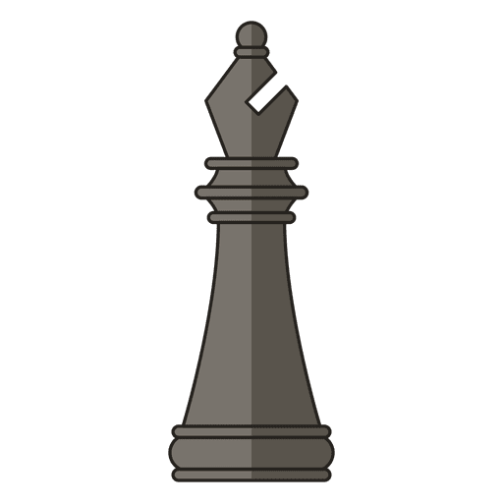
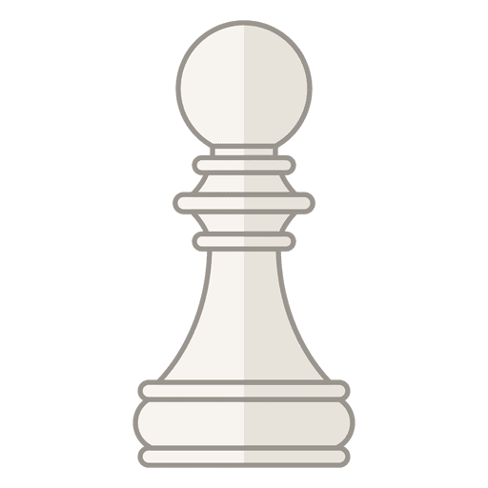
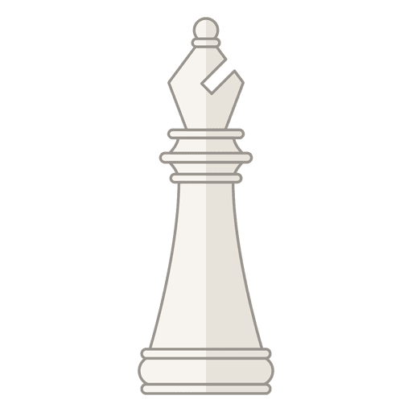
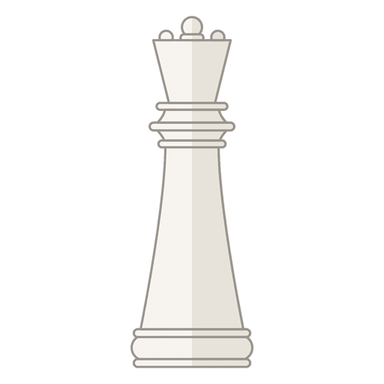
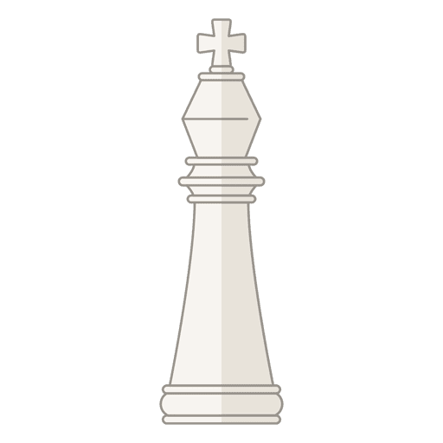
How to Play

Slide 9
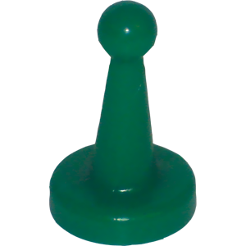
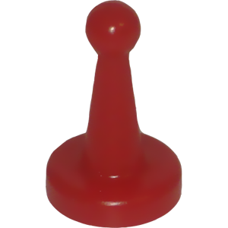
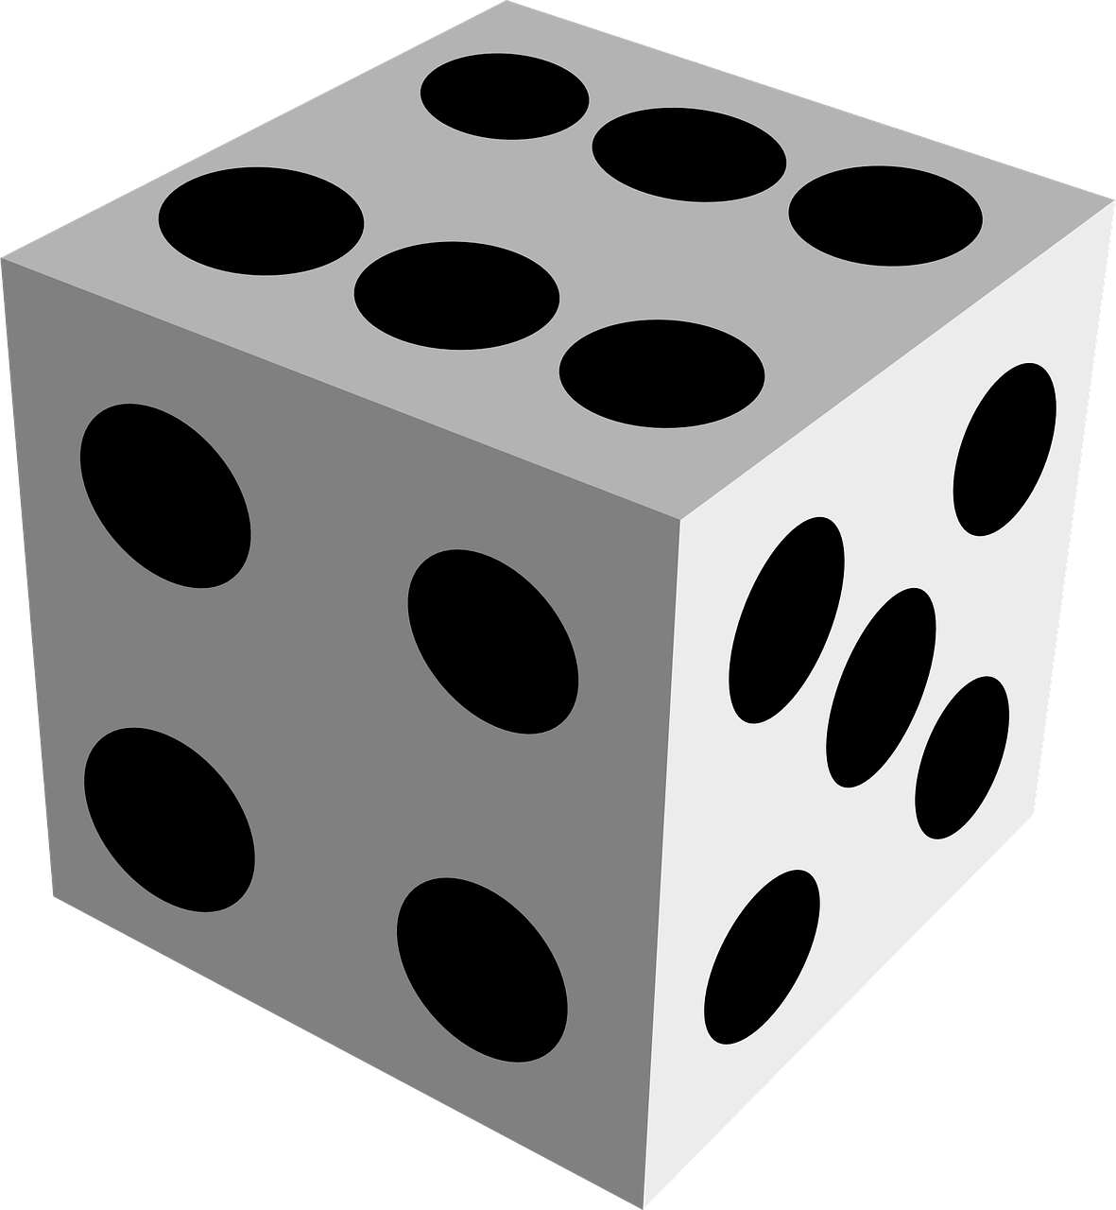
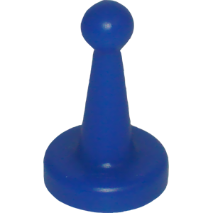
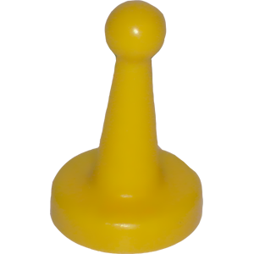

Slide 10
Tic-Tac-Toe
Goal - To get three in a row
Preparation - The first player is known as X and the second is O
Play - Players alternate placing Xs and Os on the game board until either opponent has three in a row or all nine squares are filled. X always goes first, and in the event that no one has three in a row, the stalemate is called a cat game.
Chinese Checkers
Goal - To be the first to player to move all ten marbles across the board and into the triangle opposite. The first player to occupy all 10 destination holes is the winner.
Preparation - Each player chooses a color and the 10 marbles of that color are placed in the appropriately colored triangle. Decide who will go 1st, 2nd...and so on. Place the appropriate colored player token in the players bar on the right side of the board.
Play - Players take turns to move a single marble of their own color. In one turn a marble may either be simply moved into an adjacent hole OR it may make one or more hops over other marbles. When each player finishes their turn they slide the “Your Turn” coin down the player bar to let the next player know it is their turn.
*Where a hopping move is made, each hop must be over a marble and into a the vacant hole directly beyond it. Each hop may be over any colored marble including the player’s own. After each hop, the player may either finish or, if possible and desired, continue by hopping over another marble. Occasionally, a player will be able to move a marble all the way from the starting triangle across the board and into the opposite triangle in one turn!

Slide 11
American Checkers
Goal - You win the game when the opponent has no more pieces or can't move (even if he/she still has pieces). If neither player can move then it is a draw or a tie.
Preparation - players set their pieces on the same color of square. All 12 pieces are set up on either end of the board.
Play - Typically the darker color pieces moves first. Each player takes their turn by moving a piece. Pieces are always moved diagonally and can be moved in the following ways:
Diagonally in the forward direction (towards the opponent) to the next dark square.
If there is one of the opponent's pieces next to a piece and an empty space on the other side, you jump your opponent and remove their piece. You can do multiple jumps if they are lined up in the forward direction. *** note: if you have a jump, you have no choice but to take it.
When a player finishes their turn they slide the “your turn” coin into their opponents color to signal they are done and it is the opponent's turn.
King Pieces
The last row is called the king row. If you get a piece across the board to the opponent's king row, that piece becomes a king. King pieces can move in both directions, forward and backward. Once a piece is kinged, the player must wait until the next turn to jump out of the king row.
Hungry Hippos
Goal - To be the player that gets the most of their own colored balls out of the pond and into their circle.
Preparation - All balls must be evenly distributed in the pond.
Play -
On a single family device - Typically the “orange” player goes first and then play moves clockwise around the pond. The first player watches the timer in the upper right corner, as soon as it goes black they begin pulling balls into their hippos circle. When the timer gets back to black they stop, count their balls, record their number, and put all their balls back into the pond. They move the “your turn” coin into the next players color. Play continues in a clockwise direction around the pond.
On multiple devices - players can all go at the same time collecting balls using the timer as their start/stop guide.

Slide 12
Mancala
Goal - To be the person with the most stones in his “mancala” pot at the end of the game.
Preparation - place four “stones” in each hole, excluding the mancala “pots” located on either end of the board.
Play - Players decide who goes first. During a turn, a player grabs all of the “stones in a hole on their side and drops them, one at a time, in succeeding holes in the direction toward their “mancala pot” Players MAY place stones in their own mancala (it counts as a hole), but they MUST skip over their opponent
S mancala. Players MAY place stones in holes on their opponent’s side if their stones to place exceed the past their mancala pot. This continues until the player has no more stones in the hold they started from. They then move the “your turn” coin to their opponents side to signal the opponent’s turn.
The game is over when a player (not both) has no more stones on his side to play. The players then count up the “stones” in their mancala pots to decide the winner.
Exceptions, twists, and variations!
*If, when dropping stones in holes, you drop a stone into your own mancala, and that is the last stone in your hand, then you get to go again.
*If, when dropping stones into holes, you drop a stone into a hole that was previously empty, AND the hole is on your side, AND that was the last stone in your hand, you take all of the stones in the hole directly above, and place them into your mancala.
Good strategy is to, on your first turn (and if you're going first), play the hole that is five holes away from your mancala. That way, the last stone you place will land in your mancala, and you get a free turn. After using your second turn, if your opponent plays a hole that is two or one hole(s) away from their mancala, play the hole that is six holes away from your mancala. You get another free turn!
Connect Four
Goal - To make a straight line of four of your own colored pieces; the line can be vertical, diagonal, or horizontal.
Preparation - Make sure all game pieces are off to the side and not in the board.
Play - Decide who will go first. First player picks up their colored playing piece, slides it across the top of the board and then “drops” (slides it down) into a column. The players piece must land as far down as it possibly can “drop” in the board. Then the player moves the “your turn” coin on their opponents colored rectangle to signal that it is their opponents turn.

Slide 13
Sorry
Goal - To get all of your pawns across the board into the Home row, which is a safe zone. The first player to get all of their pawns Home wins.
Preparation - Make sure each player has 4 pawn in their start circle. Choose which player will go first and place their player token in the first player spot. Play typically moves clockwise around the board.
Play - Player one will roll, if they roll a 1 or 2 they move a pawn onto the board. If they do not roll a 1 or 2 the play moves to the next person so player one will slide the “your turn” coin down to player 2. Play continues like this until a player(s) have pawns on the board. Once a player has a pawn(s) on the board they move their pawn(s) according to the numbers they roll.
Jumping/Bumping: You may jump over a pawn (yours or an opponents) that is in your path if you have sufficient movement points. However, two pawns can’t occupy the same spot on the board, so if you land on a space that contains another pawn, bump it back to its “START” circle.
Home (safety) zones: Only you may enter your Home Zone. All normal rules apply. Note, you can’t move backwards into your safety zone.
Twists - If you choose to play with a dice with more than 6 sides.
1—Move a pawn onto the outer starting circle, or move a pawn one space forward.
2— Move a pawn onto the outer starting circle, or move a pawn two spaces forward. Draw again, even if you couldn’t move a pawn.
3—Move a pawn forward three spaces.
4—Move a pawn backward four spaces.
5—Move a pawn forward five spaces.
7—Move a pawn forward seven spaces, or split the movement between two pawns. 7’s can’t be used to start a pawn. If a 7 is used to move on pawn home, the remainder of the movement total must be used exactly by another pawn or it is not a legal move.
8— Move a pawn forward eight spaces.
10—Move a pawn forward 10 spaces, or move a pawn backward one space.
11—Move a pawn forward 11 spaces, or switch the position of any one of your pawns with any one of your opponents pawns. Note, you do not have to switch positions if there is no other legal play. This is the exception to the aforementioned rule. Also, you cannot switch with pawns in the “START”, “HOME”, or “SAFETY ZONE” areas. Remember to slide and bump if your switch lands you on the starting triangle of a Safety Zone.
12—Move a pawn forward 12 spaces.

